Slide 1
UNIT 3
DATABASE DESIGN
( DEPARTMENT OF COMPUTER SCIENCE AND ENGINEERING )
TOPIC : DEPENDENCIES AND ITS TYPES

Slide 2
DEPENDENCIES
Dependencies in DBMS is a relation between two or more attributes. It has the following types in DBMS −
Functional Dependency
Fully-Functional Dependency
Transitive Dependency
Multivalued Dependency
Partial Dependency

Slide 3
Functional Dependency
If the information stored in a table can uniquely determine another information in the same table, then it is called Functional Dependency. Consider it as an association between two attributes of the same relation.
If P functionally determines Q, then
P->Q
Let us see an example −
<Employee>
In the above table, EmpName is functionally dependent on EmpID because EmpName can take only one value for the given value of EmpID:
EmpID | EmpName | EmpAge
E01 | Amit | 28
E02 | Rohit | 31

Slide 4
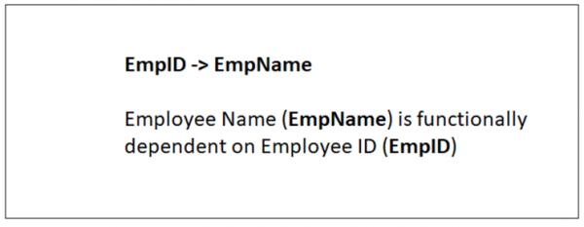
The same is displayed below −
EmpID -> EmpName

Slide 5
Fully-functionally Dependency
An attribute is fully functional dependent on another attribute, if it is Functionally Dependent on that attribute and not on any of its proper subset.
For example, an attribute Q is fully functional dependent on another attribute P, if it is Functionally Dependent on P and not on any of the proper subset of P.
Let us see an example −
<ProjectCost>
ProjectID | ProjectCost
001 | 1000
002 | 5000

Slide 6
<EmployeeProject>
The above relations states:
EmpID, ProjectID, ProjectCost -> Days
EmpID | ProjectID | Days (spent on the project)
E099 | 001 | 320
E056 | 002 | 190

Slide 7
However, it is not fully functional dependent.
Whereas the subset {EmpID, ProjectID} can easily determine the {Days} spent on the project by the employee.
This summarizes and gives our fully functional dependency −
{EmpID, ProjectID} -> (Days)

Slide 8
Transitive Dependency:
When an indirect relationship causes functional dependency it is called Transitive Dependency.
If P -> Q and Q -> R is true, then P-> R is a transitive dependency.
Multivalued Dependency
When existence of one or more rows in a table implies one or more other rows in the same table, then the Multi-valued dependencies occur.
If a table has attributes P, Q and R, then Q and R are multi-valued facts of P.
It is represented by double arrow −
->->

Slide 9
Partial Dependency
Partial Dependency occurs when a nonprime attribute is functionally dependent on part of a candidate key.
The 2nd Normal Form (2NF) eliminates the Partial Dependency. Let us see an example −
<StudentProject>
StudentID | ProjectNo | StudentName | ProjectName
S01 | 199 | Katie | Geo Location
S02 | 120 | Ollie | Cluster Exploration

Slide 10
In the above table, we have partial dependency; let us see how −
The prime key attributes are StudentID and ProjectNo.
As stated, the non-prime attributes i.e. StudentName and ProjectName should be functionally dependent on part of a candidate key, to be Partial Dependent.
The StudentName can be determined by StudentID that makes the relation Partial Dependent.
The ProjectName can be determined by ProjectID, which that the relation Partial Dependent.

