Slide 1
UNIT 3
DATABASE DESIGN
( DEPARTMENT OF COMPUTER SCIENCE AND ENGINEERING )
TOPIC : NORMALIZATION , First normal form and Second normal form

Slide 2
NORMALIZATION
Normalization is the process of minimizing redundancy from a relation or set of relations. Redundancy in relation may cause insertion, deletion, and update anomalies. So, it helps to minimize the redundancy in relations. Normal forms are used to eliminate or reduce redundancy in database tables.
TYPES OF NORMAL FORMS:
FIRST NORMAL FORM
SECOND NORMAL FORM
THIRD NORMAL FORM
BCNF FORM
FOURTH NORMAL FORM
FIFTH NORMAL FORM

Slide 3
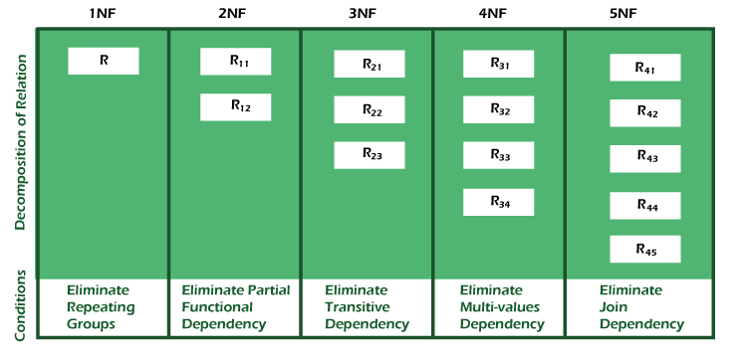

Slide 4
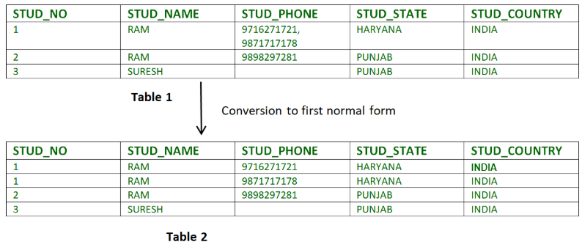
1. First Normal Form –
If a relation contain composite or multi-valued attribute, it violates first normal form or a relation is in first normal form if it does not contain any composite or multi-valued attribute. A relation is in first normal form if every attribute in that relation is singled valued attribute.
EG:
Relation STUDENT in table 1 is not in 1NF because of multi-valued attribute STUD_PHONE. Its decomposition into 1NF has been shown in table 2.

Slide 6
2. Second Normal Form –
To be in second normal form, a relation must be in first normal form and relation must not contain any partial dependency. A relation is in 2NF if it has No Partial Dependency, i.e., no non-prime attribute (attributes which are not part of any candidate key) is dependent on any proper subset of any candidate key of the table.
Partial Dependency – If the proper subset of candidate key determines non-prime attribute, it is called partial dependency.

Slide 7
Here, COURSE_FEE cannot alone decide the value of COURSE_NO or STUD_NO; COURSE_FEE together with STUD_NO cannot decide the value of COURSE_NO; COURSE_FEE together with COURSE_NO cannot decide the value of STUD_NO; Hence, COURSE_FEE would be a non-prime attribute, as it does not belong to the one only candidate key {STUD_NO, COURSE_NO} ; But, COURSE_NO -> COURSE_FEE, i.e., COURSE_FEE is dependent on COURSE_NO, which is a proper subset of the candidate key. Non-prime attribute COURSE_FEE is dependent on a proper subset of the candidate key, which is a partial dependency and so this relation is not in 2NF.

Slide 8
To convert the above relation to 2NF, we need to split the table into two tables such as : Table 1: STUD_NO, COURSE_NO Table 2: COURSE_NO, COURSE_FEE
COURSE_NO | COURSE_FEES
C1 | 1000
C2 | 1500
C3 | 1000
C4 | 2000
C5 | 2000
NOTE: 2NF tries to reduce the redundant data getting stored in memory. For instance, if there are 100 students taking C1 course, we don’t need to store its Fee as 1000 for all the 100 records, instead, once we can store it in the second table as the course fee for C1 is 1000.

