Slide 1
SNS COLLEGE OF TECHNOLOGY
Coimbatore-35
An Autonomous Institution
Accredited by NBA – AICTE and Accredited by NAAC – UGC with ‘A++’ Grade
Approved by AICTE, New Delhi & Affiliated to Anna University, Chennai
DEPARTMENT OF ENGLISH
23ENT101- COMMUNICATIVE ENGLISH
I YEAR / I SEMESTER
TOPIC : SUBJECT VERB AGREEMENT

Slide 2
Look at the below pictures carefully and come up with your observations
WHAT IS A SUBJECT? AND WHAT IS A VERB?
WHAT DO YOU KNOW ABOUT MAIN VERB AND HELPING VERB

Slide 3
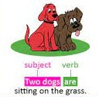
Plural subjects take plural verbs
Singular subjects must have singular verbs.

Slide 4
When two subjects are joined by ‘and’, the verb is plural.
Example:
A car and a bike are my means of transportation.
Apples and Oranges are my favorite fruits.
Annie and her brothers are at school.
Use a singular verb when two or more subjects are connected by and refer to the same person or thing. Example:
The bread and butter is my favourite food.
Breaking and entering is against the law.
Peanut butter and jelly is my favorite sandwich. (intended sense of singular)

Slide 5
If a sentence begins with HERE or THERE, the verb agrees
with the subject which follows it.
Examples
Here comes^{(verb)} the lion^{( singular} ^{subject)}.
There is a pond ^{( singular} ^{subject)}. near the house.
There are some candies ^{(Plural subject)} on the table.
Here are the chocolates.
Titles of books, movies, novels, etc. are treated as singular and take a singular verb.
Example
The Thousand and One Nights is a collection of
Middle Eastern folk tales
The Lord of the Rings” is a popular fantasy series by J.R.R. Tolkien.
“Gone with the Wind” remains a beloved film from the 1930s.

Slide 6
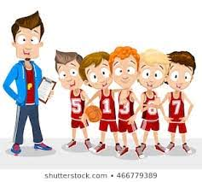
If one subject is singular and one plural and the words are connected by either/or or neither/nor, the verb agrees with the nearer subject.
Example
Neither the players nor the coach is joining.
Either my shoes or your coat is always on the floor.
Either the teacher or the students have the keys
Two singular subjects connected by or, either/or, or neither/nor require a singular verb.
Examples:
My aunt or my uncle is arriving by train today.
Either my mother or my father is coming to the meeting.
If the subjects are both plural and are connected by the words or, nor, neither/nor, either/or, and not only/but also, the verb is plural.
The dogs or the cats are making a lot of noise.
Not only the birds but also the squirrels are gathering food for winter.

Slide 7
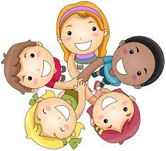
When the subject is followed by words such as ‘as well as’, ‘along with’, ‘together with’, ‘accompanied by’, ‘besides’, use a singular verb if the subject is These words and phrases are not part of the subject. Ignore them and use a singular verb when the subject is singular.
Examples: The politician, along with the newsmen, is expected shortly. Excitement, as well as nervousness, is the cause of her shaking.
The boys, accompanied by their teacher Mr. Robbins are planning a tour
Indefinite pronouns (everyone, each one, someone, somebody, no one, nobody, anyone, anybody etc.) are always singular.
Examples
Everyone agrees with the plan.
Everything comes back eventually.
Something is bothering him.

Slide 8
The following words are always plural: PANTS, TROUSERS, PLIERS, SCISSORS, SHEARS, TONGS.
Examples
The pants are torn into two.
My pants are in the drawer.
Your eyeglasses are dirty.
These scissors are useles
However, if the word PAIR is used, the verb is singular.
A pair of pants is needed.
This pair of trousers is ugly.
The pair of scissors was placed on the table.

Slide 9
ASSESSMENT
CORRECT THE FOLLOWING SENTENCES USING SUBJECT -VERB AGREEMENT
Iron as well as gold are found in India.
Bread and butter are wholesome food.
Not one of you have done their work properly.
Each of the boys were rewarded.
No news are good.
Physics are my favourite subject.
The rich help the poor.

Slide 10
Certain nouns, though plural in form, are singular in meaning
and therefore take singular verbs.
Examples
The latest news is alarming to the public.
Mathematics is my favorite subject
Use a singular verb with distances, periods of time, sums of money, etc., when considered as a unit.
Examples: Three miles is too far to walk.
62 years is the minimum age of retirement.
Five years is the maximum sentence for that offense. Ten dollars is a high price to pay. BUT, Ten dollars (i.e., dollar bills) were scattered on the floor.

Slide 11
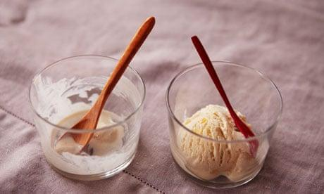
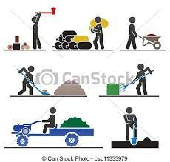
The indefinite pronouns SEVERAL, FEW, BOTH, MANY , OTHERS are always plural.
Example
Some of the ice cream is left.
Few of the students were present in class today.
Both of them are talented musicians.
If the + an adjective appears as the subject of a sentence, it will be plural.
Example
The industrious are always not successful.
The young are the future of the country.

Slide 12
Collective nouns are usually regarded as singular subjects.
Example
A flock of sheep always moves together
The crowd enjoys the excitement in the game.
The herd of cattle is grazing in the field.
The team is playing well tonight.
Uncountable nouns are always followed by singular verbs.
Education is the gate to success.
Health is the greatest asset. Diabetes affects many people around the world.
.

Slide 13
If a gerund or an infinitive comes as a subject, the verb will always be singular.
Example:
Swimming is a good exercise.
Singing is my favorite hobby.
Playing video games is a waste of time.
Learning new things is exciting.
Walking is a good habit.
Eating healthy food makes you healthy

Slide 14
ASSESSMENT
CHOOSE THE CORRECT FORM OF THE VERB THAT AGREES WITH THE SUBJECT
1. Annie and her brothers (is, are) at school.
2. Either my mother or my father (is, are) coming to the meeting.
3. The dog or the cats (is, are) outside.
4. Either my shoes or your coat (is, are) always on the floor.
5. George and Tamara (doesn't, don't) want to see that movie.
6. Benito (doesn't, don't) know the answer.
7. One of my sisters (is, are) going on a trip to France.
8. The man with all the birds (live, lives) on my street.
9. The movie, including all the previews, (take, takes) about two hours to watch.
10. The players, as well as the captain, (want, wants) to win

Slide 15
References
https://www.learngrammar.net/english-grammar/subject-verb-agreement-rules-examples
https://www.englishpractice.com/quiz/verbs-exercise-iii/

