Slide 1
SNS COLLEGE OF TECHNOLOGY
Coimbatore-35
An Autonomous Institution
Accredited by NBA – AICTE and Accredited by NAAC – UGC with ‘A++’ Grade
Approved by AICTE, New Delhi & Affiliated to Anna University, Chennai
DEPARTMENT OF ENGLISH
23ENT101- COMMUNICATIVE ENGLISH
I YEAR / I SEMESTER
TOPIC : Articles

Slide 2
ARTICLES(ADJECTIVE – MODIFIES NOUN TO SHOW
WHETHER THE NOUN IS SPECIFIC OR NON - SPECIFIC
IN-DEFINITE
(A, AN)
DEFINITE
(The)

Slide 3
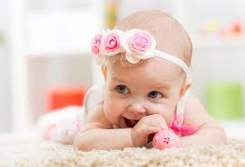
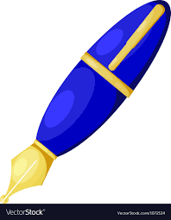
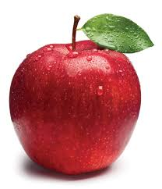
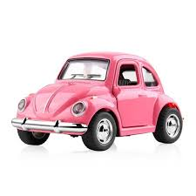
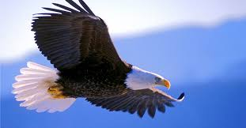
USES OF A AND AN
We use A before the words of consonants soundsb,c,d,f,h,j,k,l,m,n,p,q,r,s,t,v,w,x,y,z.
Before countable nouns
We use An before the words of vowels sounds a,e,i,o,u
Before countable nouns
a pen
a baby
a car
an apple
an umbrella
an eagle

Slide 4
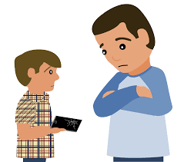
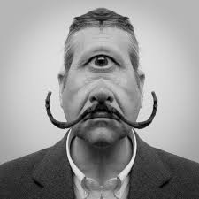
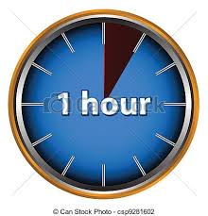
USES OF A AND AN
Before the word “one’ which begins with the consonant sound of ‘wa’.
Before the names of jobs and professions
Before a word with silent’h’.
an honest boy
a one eyed man
A one rupee note
an hour
a doctor

Slide 5
ASSESSMENT
Supply suitable Articles for the following Words and give your justification:-
Unicorn, Uniform, Unique, Union,MBA, Ncc, MLA, X-ray University, European

Slide 6
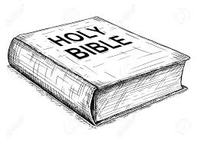
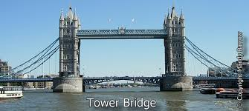
USE OF THE
Used with both countable and uncountable nounts
To talk about person/thing again
Seas ,oceans and directions,geographical areas
Museums and art galleries
Rivers The Nile, DesertsThe sahara, Gulfs The gulf of Mannar,forests The Black forest, Pennisulas The Arabian pennisula
Musical instruments
Periods and events in history
Bridges, Before the names of bays Bay of Bengal
Before the names of unique nouns
Superlative adjectives
Holy books, newspapers and magazines
Before an adjective is when the noun is understood
Before the names of Holy books
The Bible
Before the names of unique things
The Sun
Before the names of Bridges
The London Bridge

Slide 7
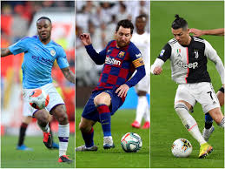
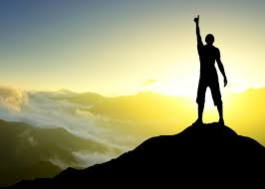
Omissions of Articles
Before school, college, university, church, bed, hospital, prison.
Before the names of meals
We use a when there is an adjective before breakfast, lunch, dinner etc. We use the when we are talking about a particular meal.
I had a late dinner yesterday.
The lunch we had at the restaurant was very good.
Before the uncountable nouns and abstract nouns Sugar is bad for your teeth.
Before the names of Languages
If we use article it refers The French man
Before the names of sports
football. It is not a/the football
Before the abstract nouns
Success
It is not a/the success

Slide 8
Omissions of Articles
Before the names of countries/territories India,Mexico except The United States, The United Kingdom.
Before the names of cities, towns, states
Before the names of streets wall street, MG road
Before the names of lakes Lake victoria except The Great Salt Lake
Before the names of single mountains Mount Everest, Mount Fuji except with mountain ranges such as The Himalayas, The Alps.
Before the names of academic subjects – biology, history
Before the names of Islands Balli. Except with group of islands The Maladives, The Andhaman and Nickobar
Before the names of continents (Asia, Europe)

Slide 9
Omissions of Articles
Before school, college, university, church, bed, hospital, prison etc.
His dad is still in hospital.
We learned English at school.
He is at university.
The is used before these words when the reference is to the building or object rather than to the normal activity that goes on there.
I met her at the church. (Here the reference is to the building and not to the activity that is going on there.)
I went to the hospital to see my friend.

Slide 10
ASSESSMENT
Complete the following sentences by filling in 'a' or 'an' or 'the' as may be suitable
1. He is not honourable man.
2. reindeer is a native of Norway.
3. Honest men speak truth.
4. Do you see blue sky?
5. Aladdin had wonderful lamp.
6. He returned after hour.
7. sun shines brightly.
8. lion is king of beasts.
9. You are fool to say that.
10. French is easy language.

Slide 11
REFERENCES
https://www.mockbank.com/bulletin/english-grammar-test-series-quiz-4/
https://www.allthingsgrammar.com/articles.html

