Slide 1
SNS COLLEGE OF TECHNOLOGY
Coimbatore-35
An Autonomous Institution
Accredited by NBA – AICTE and Accredited by NAAC – UGC with ‘A++’ Grade
Approved by AICTE, New Delhi & Affiliated to Anna University, Chennai
DEPARTMENT OF ENGLISH
23ENT101- COMMUNICATIVE ENGLISH
I YEAR / I SEMESTER
UNIT 4
TOPIC : NoteMaking

Slide 2
Note Making
It is an important Reading skill. It involves the identification of main ideas or Governing thought, supported by relevant data and information. Notes are usually prepared to record a speech or dictation while listening to it. It helps us to refer back and reproduce the same in desired way.
2/12

Slide 3
Guess What it is?
Observe the picture for a minute to find out the connection with topic.
3/9

Slide 4
Various sources of Making Notes
Book
It is a way of recording important details from a source.
Article
Meeting
It can be a
Oral discussion
4/12

Slide 5
How to Make Notes?
Read the given Passage
Underline the important words & sentences
Procedure for Note Making
Arrange it in a sequential order
Don’t change the main idea of
the given passage

Slide 6
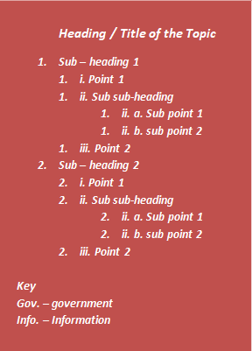
How to write Notes?
Heading
Note Making Format
Subheading
Point
Sub-subheading
Key or Keywords &
Abbreviations

Slide 7
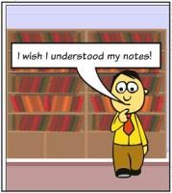
Points to Remember for Note Making Format
Avoid using long sentences as heading or title
Never lose the main idea of the passage
Ignore information that is less important
Be brief, clear, and specific
Use logical sequencing
It is vital to give each note a meaningful title and to maintain proper indentation.
Only the most important instances should be provided.
The presentation of this writing skill is critical.
Leave no spaces to avoid confusion
Do not include your own version or understandings
At least four abbreviations must be included in your notes. To make it apparent to the reader, put a full stop after each abbreviation.
Make your note more memorable by adding colours, drawings, and symbols

Slide 8
Using Abbreviations and Symbols in Note Making
Using abbreviations and symbols when taking notes saves time and space. There are several techniques to shorten long or intricate words:
Using the initials of one or more words, for example, Prime Minister – PM, India – IND, United Nations – UN, Chief Marketing Officer – CMO.
Using only the initial few letters of the words, for example, construction –
Const., abbreviation – abbr., information – info., and so on.
Universally recognised abbreviations include, for example, opposite – opp., government – govt., established – est., private limited – Pvt. Ltd, department – dept., etcetera – etc., that is – i.e., etc.
Removing the vowels, for example, reading – rdng, books – bks, cleaning –
clng, shopping – shppng, and so on.
Universally recognised symbols, for example, Q because > greater, larger, <
less, smaller, ↓ falling, decreasing, ↑ rising, increasing.

Slide 9
Benefits of Note Making
Effective use in exams &academic writing
Can use for future reference in any organisation
Keeps information in handy
Recall the past shared information
Notes are short and also arranged in logical way with complete information.

Slide 10
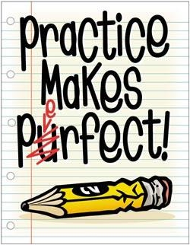
Conversation is indeed the most easily teachable of all arts. All you need to do in order to become a good conversationalist is to find a subject that interests you and your listeners. There are, for example, numberless hobbies to talk about. But the important thing is that you must talk about other fellow’s hobby rather than yours’. Talk to your friends about the things that interest them, and you will get a reputation for good fellowship, and a brilliant mind. There is nothing that pleases people so much as your interest in their interest.
It is just as important to know what subjects to avoid and what subjects to select for good conversation. If you don’t want to be set down as a bore, be careful to avoid certain unpleasant subjects. Avoid talking about yourself, unless you are asked to do so. People are interested in their own problems not in yours.
To be a good conversationalist you must know not only what to say, but how also to say it. Be mentally quick and witty. Finally, try to avoid mannerism in your conversation. Don’t click your tongue, or roll your eyes or use your hands excessively as you speak.

Slide 11
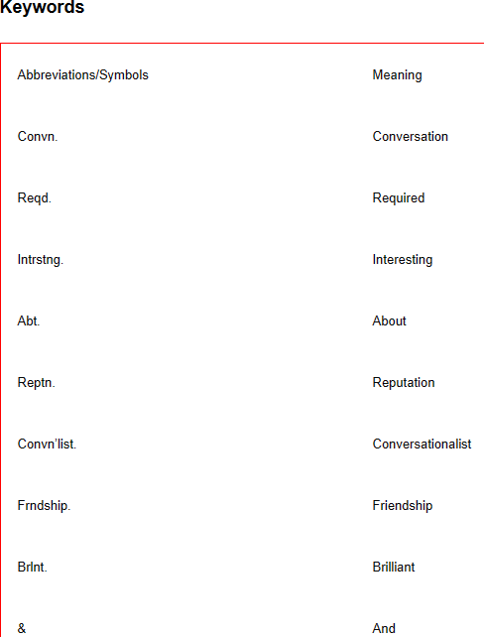
The Art of Conversation (The Title for the passage)
1.Convn. – most easily tchble. art
Reqd. intrstng. subject – hobbies
Talk abt. other fellow’s hobby
Winning reptn. as good convn’list.
Good frndship.
Brlnt. Mind.
Fit subj. for convn.
What subj. to select/ avoid?
Avoid unpleasant subj.
Avoid talking abt. self
Qualities of a good convn’list.
What to say & how to say
Mentally quick & witty
Avoid mannerisms.

Slide 12
References
https://www.dawn.com/news/1292418 https://inkfactorystudio.com/blog/powerful-science-behind-visual-notetaking/
https://www.thebluediamondgallery.com/handwriting/p/procedure.html https://www.123rf.com/photo_49668437_a-3d-people-s-work-procedures.html
http://www.clipartpanda.com/clipart_images/word-benefits-clip-art-59822141
12/12

